Slide 1
Introduction to
Computer Graphics with OpenGL/GLUT

Slide 2
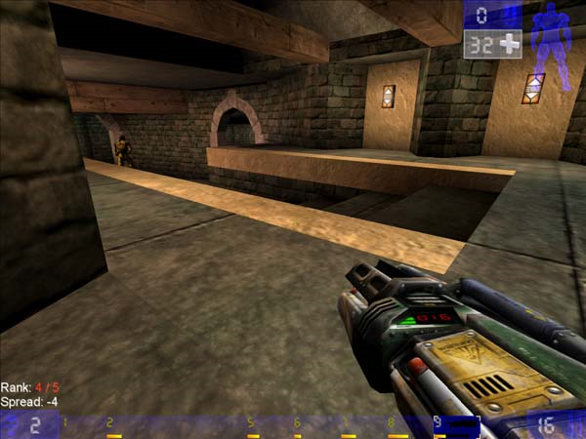
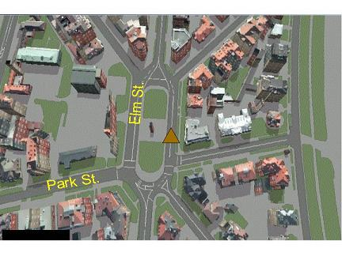
What is OpenGL?

Slide 3
What is OpenGL?
A software interface to graphics hardware
Graphics rendering API (Low Level)
  High-quality color images composed of geometric and image primitives
  Window system independent
  Operating system independent
Notes:
Application Programming Interface

Slide 4
Maximal Portability
Display device independent
Window system independent
Operating system independent
Without a standard API (such as OpenGL) - impossible to port
(100, 50)
Line(100,50,150,80) - device/lib 1
Moveto(100,50) - device/lib 2
Lineto(150,100)
(150, 100)

Slide 5

OpenGL Basics
OpenGL’s primary function – Rendering
Rendering? – converting geometric/mathematical object descriptions into frame buffer values
OpenGL can render:
  Geometric primitives
  Bitmaps and Images (Raster primitives)

Slide 6

OpenGL Basics
Rendering
  Typically execution of OpenGL commands
  Converting geometric/mathematical object descriptions into frame buffer values
OpenGL can render:
  Geometric primitives
    Lines, points, polygons, etc…
  Bitmaps and Images
    Images and geometry linked through
    texture mapping
Graphics Pipeline

Slide 7
OpenGL and GLUT
GLUT (OpenGL Utility Toolkit)
  An auxiliary library
    A portable windowing API
    Easier to show the output of your OpenGL application
    Not officially part of OpenGL
  Handles:
    Window creation,
    OS system calls
      Mouse buttons, movement, keyboard, etc…
    Callbacks

Slide 8
How to install GLUT?
Download GLUT
  http://www.opengl.org/resources/libraries/glut.html
Copy the files to following folders:
  glut.h → VC/include/gl/
  glut32.lib → VC/lib/
  glut32.dll → windows/system32/
Header Files:
  #include <GL/glut.h>
  #include <GL/gl.h>
  Include glut automatically includes other header files

Slide 9
GLUT Basics
Application Structure
  Configure and open window
  Initialize OpenGL state
  Register input callback functions
    render
    resize
    input: keyboard, mouse, etc.
  Enter event processing loop

Slide 10











The Latest Pipelines of OpenGL 4.X
Vertex
Data
Vertex
Shader
Primitive
Setup and Rasterization
Fragment
Shader
Blending
Tessellation
Control
Shader
Tessellation
Evaluation
Shader
Geometry
Shader
Pixel
Data
Texture
Store
OpenGL 4.1 (released July 25th, 2010) included additional shading stages – tessellation-control and tessellation-evaluation shaders
Latest version is 4.5 / August 11, 2014

Slide 11
Sample Program
#include <GL/glut.h>
#include <GL/gl.h>
void main(int argc, char** argv)
{
int mode = GLUT_RGB|GLUT_DOUBLE;
glutInitDisplayMode( mode );
glutInitWindowSize( 500,500 );
glutCreateWindow( “Simple” );
init();
glutDisplayFunc( display );
glutKeyboardFunc( key );
glutMainLoop();
}

Slide 12
Sample Program
#include <GL/glut.h>
#include <GL/gl.h>
void main(int argc, char** argv)
{
int mode = GLUT_RGB|GLUT_DOUBLE;
glutInitDisplayMode( mode );
glutInitWindowSize( 500,500 );
glutCreateWindow( “Simple” );
init();
glutDisplayFunc( display );
glutKeyboardFunc( key );
glutMainLoop();
}
Specify the display
Mode – RGB or color
Index, single or double
Buffer

Slide 13
Sample Program
#include <GL/glut.h>
#include <GL/gl.h>
void main(int argc, char** argv)
{
int mode = GLUT_RGB|GLUT_DOUBLE;
glutInitDisplayMode( mode );
glutInitWindowSize( 500,500 );
glutCreateWindow( “Simple” );
init();
glutDisplayFunc( display );
glutKeyboardFunc( key );
glutMainLoop();
}
Create a window
Named “simple”
with resolution
500 x 500

Slide 14
Sample Program
#include <GL/glut.h>
#include <GL/gl.h>
void main(int argc, char** argv)
{
int mode = GLUT_RGB|GLUT_DOUBLE;
glutInitDisplayMode( mode );
glutInitWindowSize( 500,500 );
glutCreateWindow( “Simple” );
init();
glutDisplayFunc( display );
glutKeyboardFunc( key );
glutMainLoop();
}
Your OpenGL initialization
code (Optional)

Slide 15
Sample Program
#include <GL/glut.h>
#include <GL/gl.h>
void main(int argc, char** argv)
{
int mode = GLUT_RGB|GLUT_DOUBLE;
glutInitDisplayMode( mode );
glutInitWindowSize( 500,500 );
glutCreateWindow( “Simple” );
init();
glutDisplayFunc( display );
glutKeyboardFunc(key);
glutMainLoop();
}
Register your call back
functions

Slide 16
glutMainLoop()
#include <GL/glut.h>
#include <GL/gl.h>
int main(int argc, char** argv)
{
int mode = GLUT_RGB|GLUT_DOUBLE;
glutInitDisplayMode(mode);
glutInitWindowSize(500,500);
glutCreateWindow(“Simple”);
init();
glutDisplayFunc(display);
glutKeyboardFunc(key);
glutMainLoop();
}
The program goes into an infinite
loop waiting for events

Slide 17
glutDisplayFunc(void (*func)(void) )
Void main(int argc, char** argv)
{
…
glutDisplayFunc(display);
…
}
void display() – the function
you provide. It contains all
the OpenGL drawing function
calls and will be called
when pixels in the window
need to be refreshed.

Slide 18
OpenGL Initialization
Set up whatever state you’re going to use
  Don’t need this much detail unless working in 3D
  void init( void )
  {
  glClearColor (0.0, 0.0, 0.0, 0.0);
    glViewport(0, 0, width, height);
    glMatrixMode(GL_PROJECTION);
    glLoadIdentity();
    glOrtho(-10, 10, -10, 10, -10, 20);
    glMatrixMode(GL_MODELVIEW);
    glLoadIdentity();
    glEnable( GL_LIGHT0 );
    glEnable( GL_LIGHTING );
    glEnable( GL_DEPTH_TEST );
  }
Notes:
glClearColor->Clears the buffer to preset color values

Slide 19
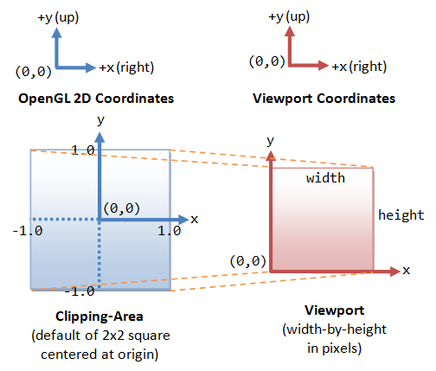
Reshape

Slide 20
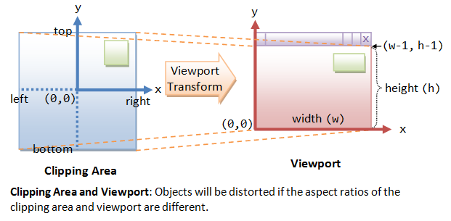
Reshape

Slide 21
Clipping Area: Clipping area refers to the area that can be seen (i.e., captured by the camera), measured in OpenGL coordinates.
The function gluOrtho2D can be used to set the clipping area of 2D orthographic view. Objects outside the clipping area will be clipped away and cannot be seen.
void gluOrtho2D(GLdouble left, GLdouble right, GLdouble bottom, GLdouble top)
// The default clipping area is (-1.0, 1.0, -1.0, 1.0) in OpenGL coordinates, // i.e., 2x2 square centered at the origin.
To set the clipping area, we need to issue a series of commands as follows: we first select the so-called projection matrix for operation, and reset the projection matrix to identity. We then choose the 2D orthographic view with the desired clipping area, via gluOrtho2D().
// Set to 2D orthographic projection with the specified clipping area glMatrixMode(GL_PROJECTION); // Select the Projection matrix for operation glLoadIdentity(); // Reset Projection matrix
gluOrtho2D(-1.0, 1.0, -1.0, 1.0); // Set clipping area's left, right, bottom, top

Slide 22
Viewport: Viewport refers to the display area on the window (screen), which is measured in pixels in screen coordinates (excluding the title bar).
The clipping area is mapped to the viewport. We can use glViewport function to configure the viewport.
void glViewport(GLint xTopLeft, GLint yTopLeft, GLsizei width, GLsizei height)
Suppose the the clipping area's (left, right, bottom, top) is (-1.0, 1.0, -1.0, 1.0) (in OpenGL coordinates) and the viewport's (xTopLeft, xTopRight, width, height) is (0, 0, 640, 480) (in screen coordinates in pixels), then the bottom-left corner (-1.0, -1.0) maps to (0, 0) in the viewport, the top-right corner (1.0, 1.0) maps to (639, 479).
It is obvious that if the aspect ratios for the clipping area and the viewport are not the same, the shapes will be distorted.

Slide 23
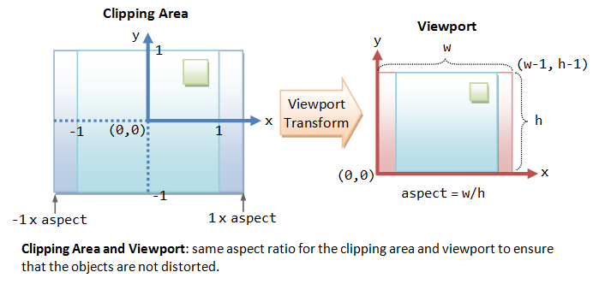
Reshape

Slide 24
GLUT Callback functions
Event-driven: Programs that use windows
  Input/Output
  Wait until an event happens and then execute some pre-defined functions according to the user’s input
Events – key press, mouse button press and release, window resize, etc.
Your OpenGL program will be in infinite loop

Slide 25
GLUT Callback Functions
Callback function : Routine to call when an event happens
  Window resize or redraw
  User input (mouse, keyboard)
  Animation (render many frames)
“Register” callbacks with GLUT
  glutDisplayFunc( my_display_func );
  glutIdleFunc( my_idle_func );
  glutKeyboardFunc( my_key_events_func );
  glutMouseFunc ( my_mouse_events_func );

Slide 26
Event Queue
Keyboard
Event queue
….
MainLoop()
Mouse
Window
Mouse_callback()
{
….
{
Keypress_callback()
{
….
{
window_callback()
{
….
{

Slide 27
Rendering Callback
Callback function where all our drawing is done
Every GLUT program must have a display callback
glutDisplayFunc( my_display_func ); /* this part is in main.c */
  void my_display_func (void )
  {
  glClear( GL_COLOR_BUFFER_BIT );
  glBegin( GL_TRIANGLE );
  glVertex3fv( v[0] );
  glVertex3fv( v[1] );
  glVertex3fv( v[2] );
  glEnd();
  glFlush();
  }

Slide 28
Idle Callback
Use for animation and continuous update
  Can use glutTimerFunc or timed callbacks for animations
glutIdleFunc( idle );
  void idle( void )
  {
/* change something */
  t += dt;
  glutPostRedisplay();
  }

Slide 29
User Input Callbacks
Process user input
glutKeyboardFunc( my_key_events );
  void my_key_events (char key, int x, int y )
  {
  switch ( key ) {
  case ‘q’ : case ‘Q’ :
  exit ( EXIT_SUCCESS);
  break;
  case ‘r’ : case ‘R’ :
  rotate = GL_TRUE;
  break;
  }
  }

Slide 30
Mouse Callback
Captures mouse press and release events
glutMouseFunc( my_mouse );
  void myMouse(int button, int state, int x, int y)
  {
      if (button == GLUT_LEFT_BUTTON && state == GLUT_DOWN)
      {
      …
      }
  }

Slide 31
Events in OpenGL
Event | Example | OpenGL Callback Function
Keypress | KeyDown KeyUp | glutKeyboardFunc
Mouse | leftButtonDown leftButtonUp | glutMouseFunc
Motion | With mouse press Without | glutMotionFunc glutPassiveMotionFunc
Window | Moving Resizing | glutReshapeFunc
System | Idle Timer | glutIdleFunc glutTimerFunc
Software | What to draw | glutDisplayFunc

Slide 32
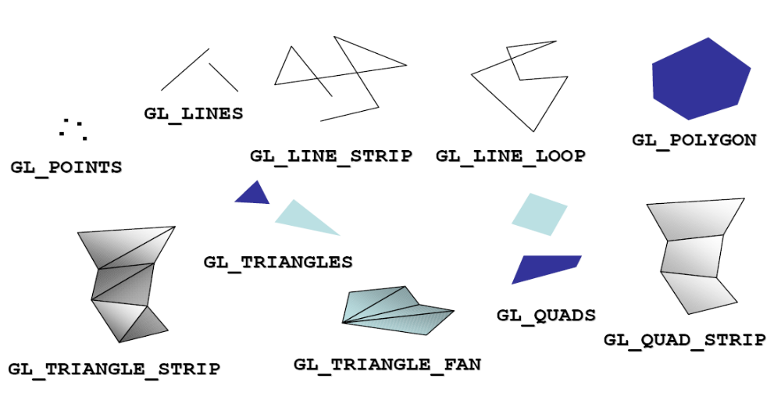
OpenGL Geometric Primitives
The geometry is specified by vertices.
There are ten primitive types:

Slide 33
Polygon Issues
OpenGL will only display polygons correctly that are
  Simple: edges cannot cross
  Convex: All points on line segment between two points in a polygon are also in the polygon
  Flat: all vertices are in the same plane
User program can check if above true
  OpenGL will produce output if these conditions are violated but it may not be what is desired
Triangles satisfy all conditions
That’s why we need triangulation algorithms!

Slide 34
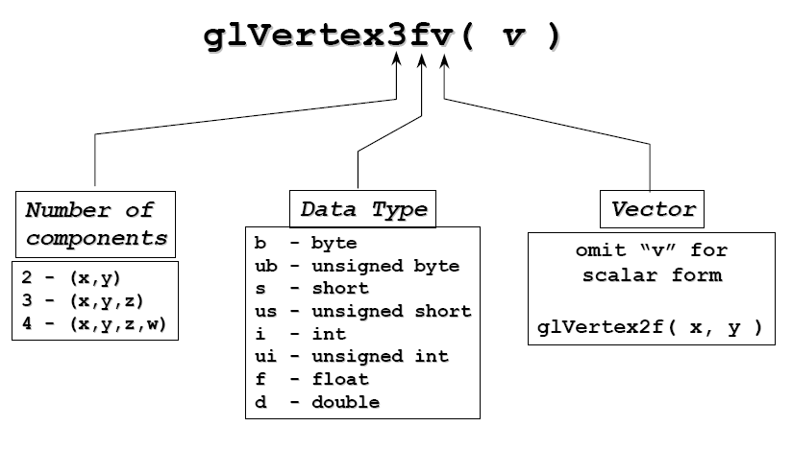
OpenGL Command Format
glVertex3fv

Slide 35
Vertices and Primitives
Primitives are specified using
  glBegin( primType );
  …
  glEnd();
  primType determines how vertices are combined
  GLfloat red, green, blue;
  Glfloat coords[nVerts][3];
  /*Initialize coords and colors somewhere in program*/
  glBegin( primType );
  for ( i = 0; i < nVerts; ++i ) {
  glColor3f( red, green, blue );
  glVertex3fv( coords[i] );
  }
  glEnd();

Slide 36
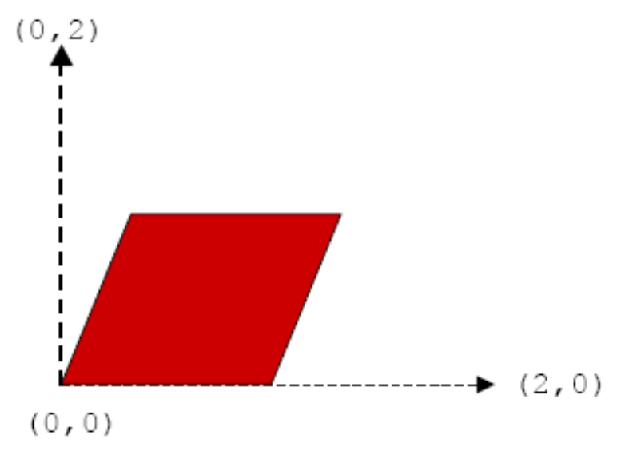
An Example
void drawParallelogram( GLfloat color[] )
{
  glBegin( GL_QUADS );
  glColor3fv( color );
  glVertex2f( 0.0, 0.0 );
  glVertex2f( 1.0, 0.0 );
  glVertex2f( 1.5, 1.118 );
  glVertex2f( 0.5, 1.118 );
  glEnd();
}

Slide 37
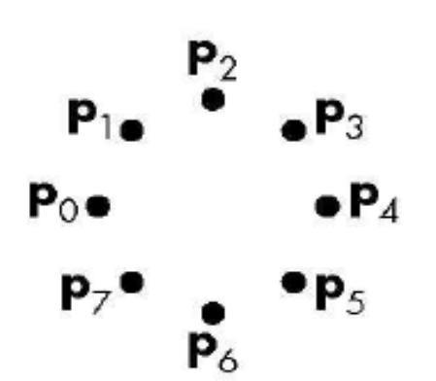

Vertices and Primitives
Points, GL_POINTS
  Individual points
  Point size can be altered
    glPointSize (float size)
glBegin(GL_POINTS);
  glColor3fv( color );
  glVertex2f( P0.x, P0.y );
  glVertex2f( P1.x, P1.y );
  glVertex2f( P2.x, P2.y );
  glVertex2f( P3.x, P3.y );
  glVertex2f( P4.x, P4.y );
  glVertex2f( P5.x, P5.y );
  glVertex2f( P6.x, P6.y );
  glVertex2f( P7.x, P7.y );
  glEnd();

Slide 38
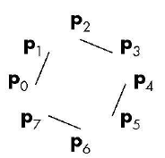
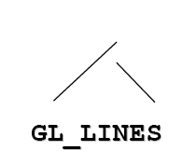
Vertices and Primitives
Lines, GL_LINES
  Pairs of vertices interpreted as individual line segments
  Can specify line width using:
    glLineWidth (float width)
glBegin(GL_LINES);
  glColor3fv( color );
  glVertex2f( P0.x, P0.y );
  glVertex2f( P1.x, P1.y );
  glVertex2f( P2.x, P2.y );
  glVertex2f( P3.x, P3.y );
  glVertex2f( P4.x, P4.y );
  glVertex2f( P5.x, P5.y );
  glVertex2f( P6.x, P6.y );
  glVertex2f( P7.x, P7.y );
  glEnd();

Slide 39
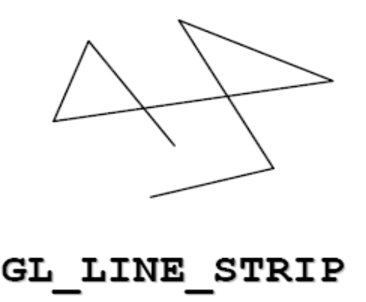
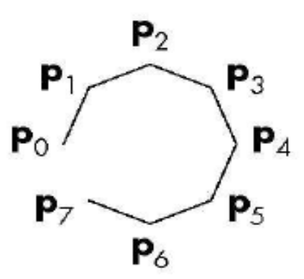
Vertices and Primitives
Line Strip, GL_LINE_STRIP
  series of connected line segments

Slide 40
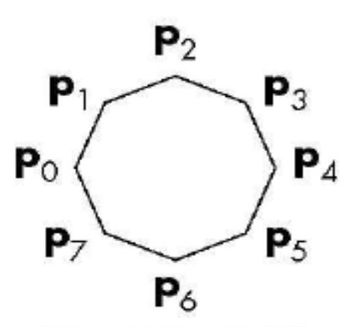
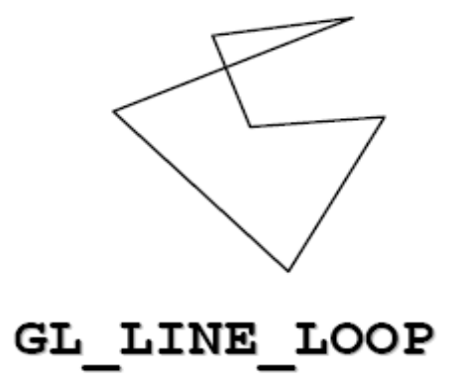
Vertices and Primitives
Line Loop, GL_LINE_LOOP
  Line strip with a segment added between last and first vertices

Slide 41

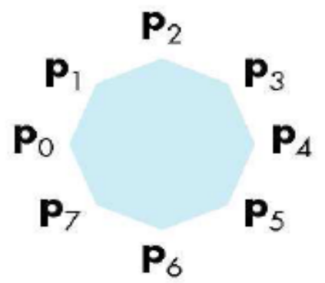
Vertices and Primitives
Polygon , GL_POLYGON
  boundary of a simple, convex polygon

Slide 42
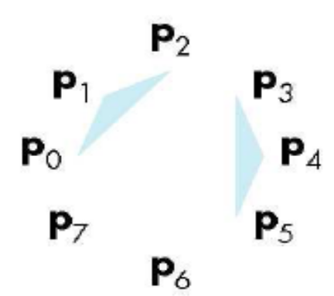

Vertices and Primitives
Triangles , GL_TRIANGLES
  triples of vertices interpreted as triangles

Slide 43
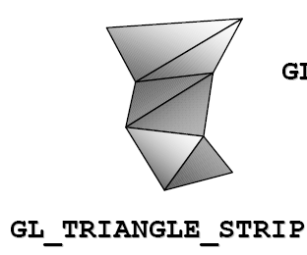
Vertices and Primitives
Triangle Strip , GL_TRIANGLE_STRIP
  linked strip of triangles
v0
v1
v2
v3
v4
v5
v7
v6

Slide 44

Vertices and Primitives
Triangle Fan , GL_TRIANGLE_FAN
  linked fan of triangles
v1
v2
v3
v4
v0
v5

Slide 45

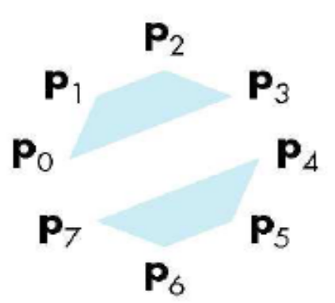
Vertices and Primitives
Quads , GL_QUADS
  quadruples of vertices interpreted as four-sided polygons

Slide 46
Vertices and Primitives
Between glBegin/ glEnd, those opengl commands are allowed:
  glVertex*() : set vertex coordinates
  glColor*() : set current color
  glIndex*() : set current color index
  glNormal*() : set normal vector coordinates (Light.)
  glTexCoord*() : set texture coordinates (Texture)

Slide 47
References
http://www.opengl.org/documentation/spec.html
http://www.opengl.org/documentation/red_book_1.0/
http://www.cs.rit.edu/~jdb/cg1/openGLIntro.pdf
http://www.ceng.metu.edu.tr/courses/ceng477/2005/documents/recitations/opengl.ppt

